Slide 1

Vehicle Detection Using CNN Models
Bangladesh Army University Of Science And Technology (BAUST), Saidpur
Department Of Computer Science And Engineering
CSE 4132 – Artificial Neural Network Sessional
CSE 10th Batch

Slide 2
Group Members
MD Al Arman Sorker (200101059)
Abu Shadat Shaikat (200101057)
Monisha Bakshi (200101055)
Aznur Azam (200101037)

Slide 3
Contents
Introduction
Objective
Dataset Description
Methodology
Models
Result Analysis
Stakeholders
Limitations
Conclusion

Slide 4
Introduction
Vehicle detection is an important task in computer vision with various practical applications such as traffic monitoring, autonomous driving, and security systems.
We use different Convolutional Neural Networks (CNN) models for vehicle detection in this project.

Slide 5
Objective
The main objective of this project is to learn how CNN can be used for vehicle detection.
By doing vehicle detection, it can help traffic department to solve traffic issue.
It can be helpful for autonomous vehicles.

Slide 6
Dataset Description
The Vehicle-Detection dataset is a collection of images with train, test, validation set.
Train-set has 12,971 images.
Test-set has 2,774 images.
Validation-set has 2,025 images.
The dataset has two classes – vehicle and non-vehicle.

Slide 7
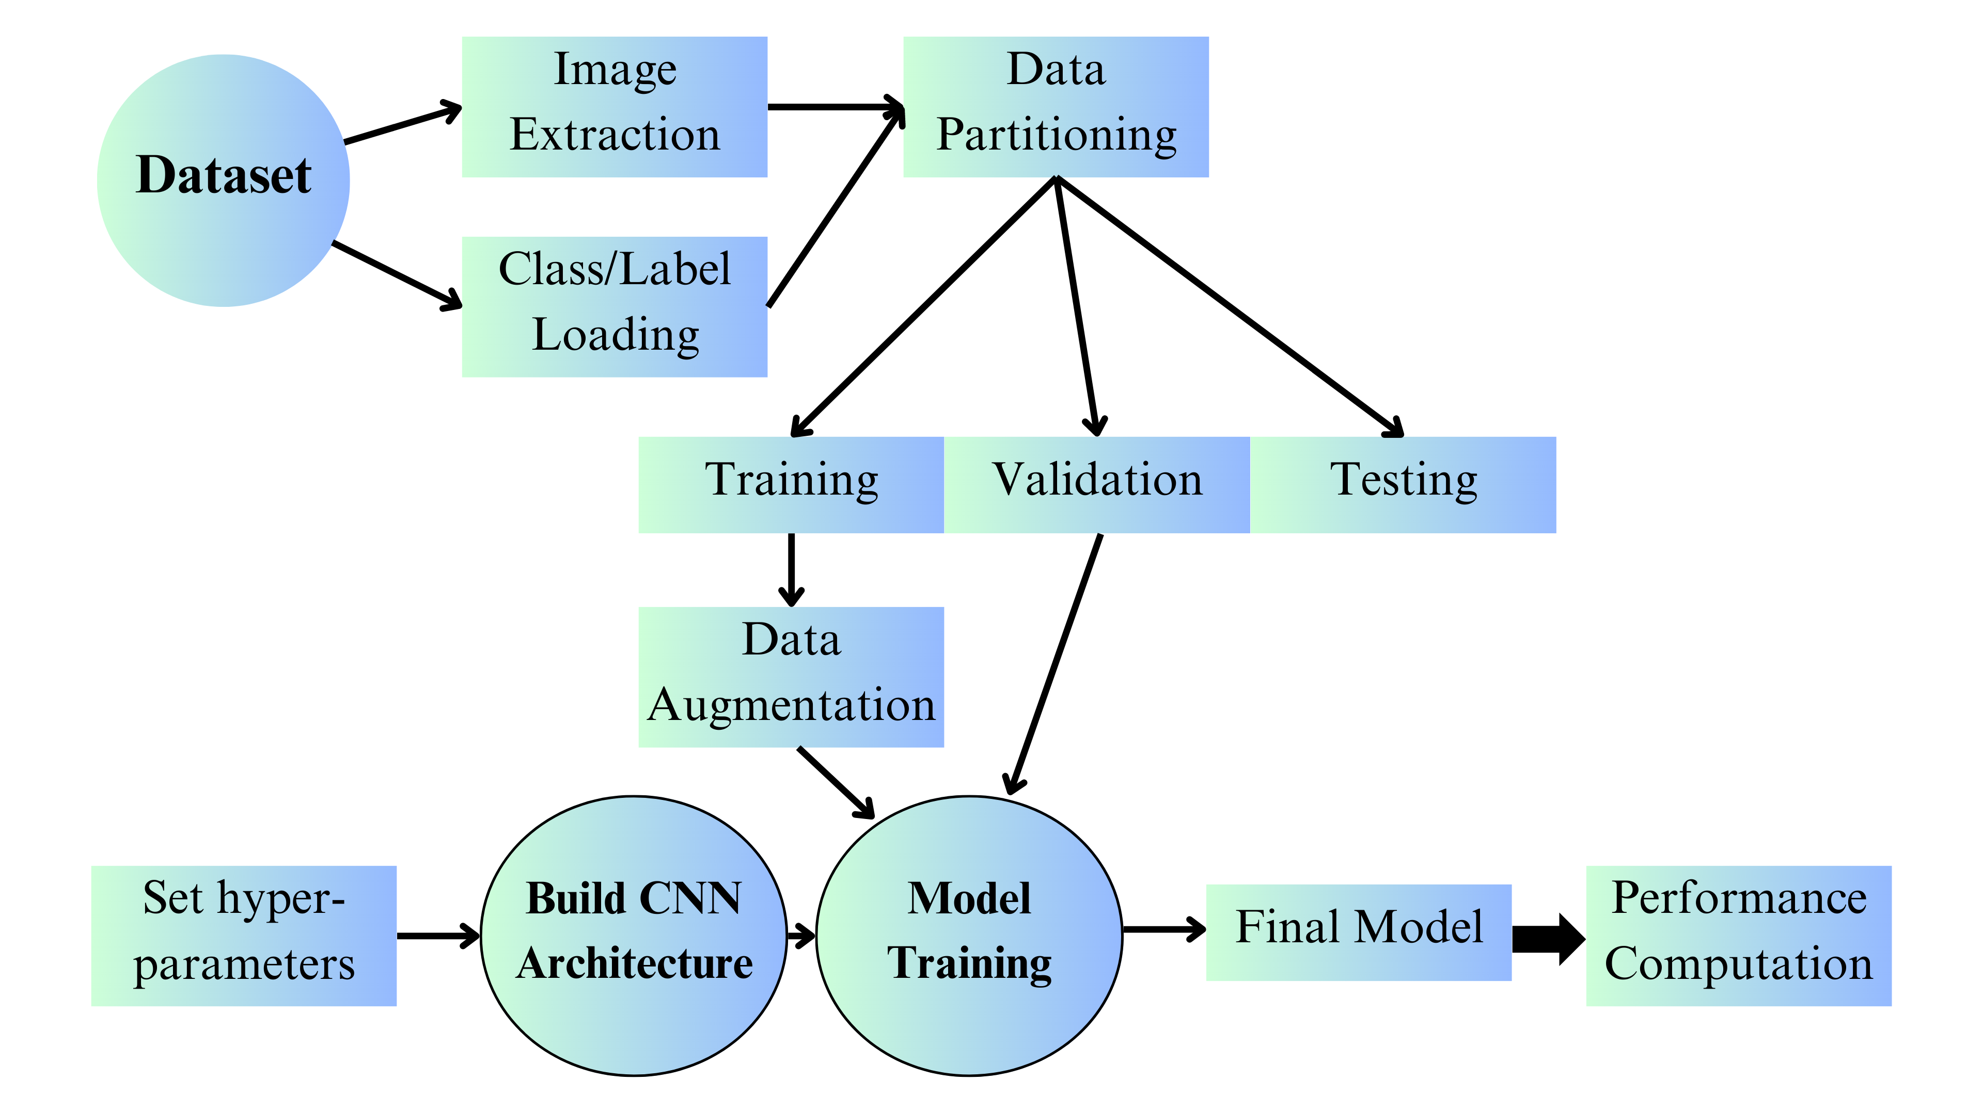
Methodology
We use DenseNet121, ResNet50, VGG16 and MobileNet CNN models in the project with Baseline, Transfer Learning, Fine Tuning Techniques.
Figure 4.1: Methodology

Slide 8
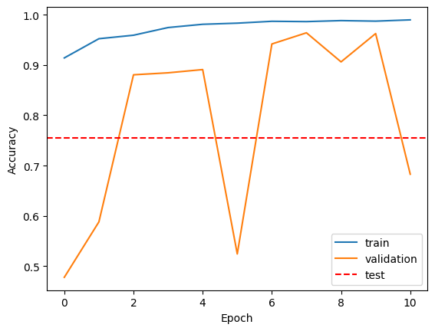
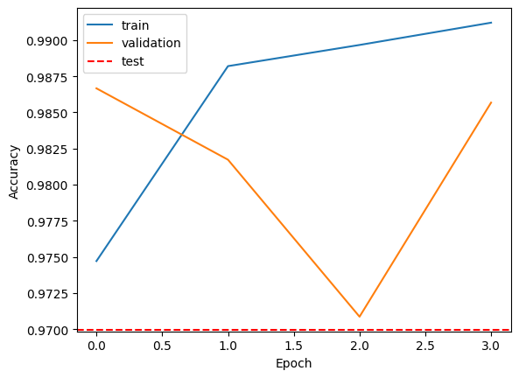
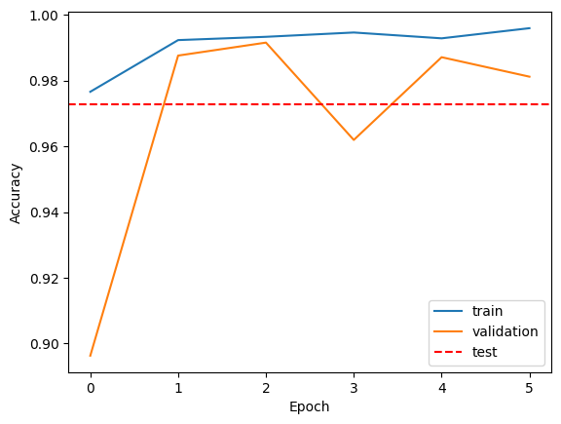
Models
DenseNet121 CNN Model
Figure 5.1: Baseline, Transfer Learning, Fine Tuning
The Transfer Learning gives better performance than baseline and fine tuning in Densenet.

Slide 9
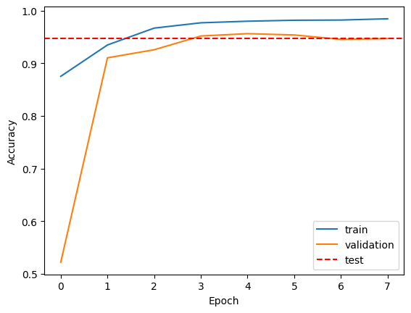
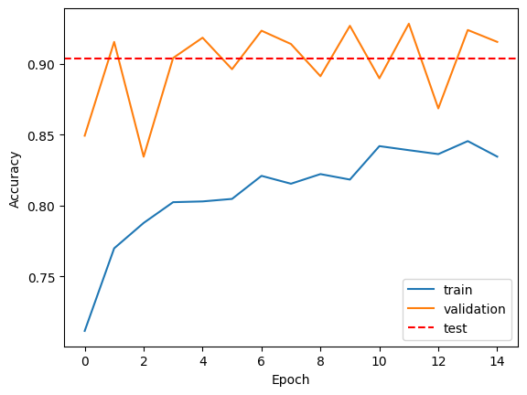
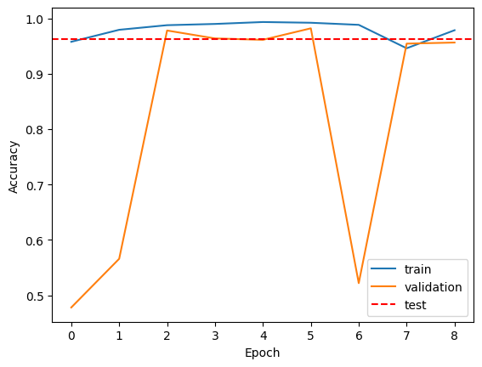
Models
ResNet50 CNN Model
Figure 5.2: Baseline, Transfer Learning, Fine Tuning
The Baseline gives better performance than transfer learning and fine tuning in ResNet50.

Slide 10
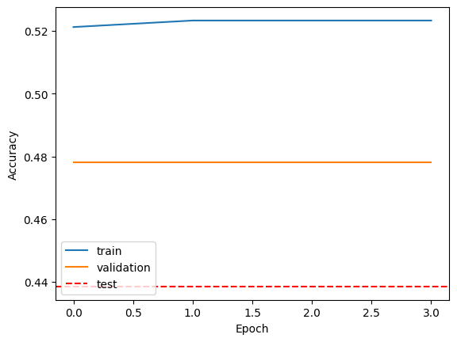
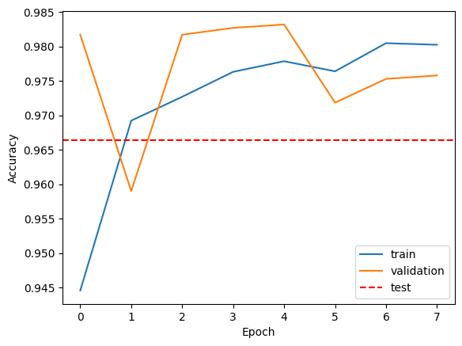
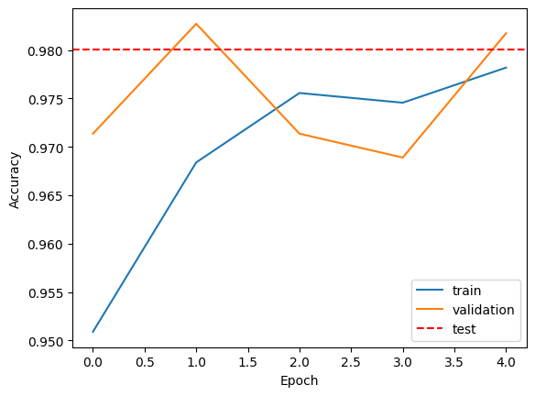
Models
VGG16 CNN Model
Figure 5.2: Baseline, Transfer Learning, Fine Tuning
The Transfer Learning gives better performance than baseline and fine tuning in VGG16.

Slide 11
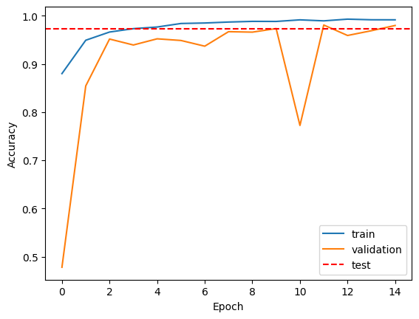
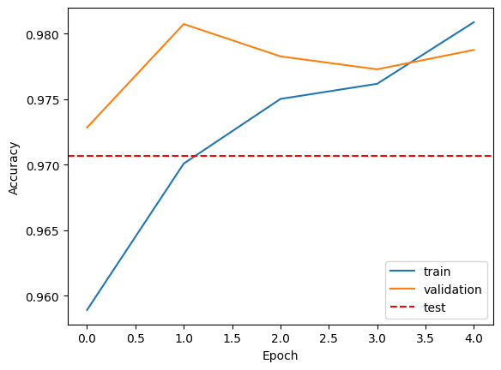
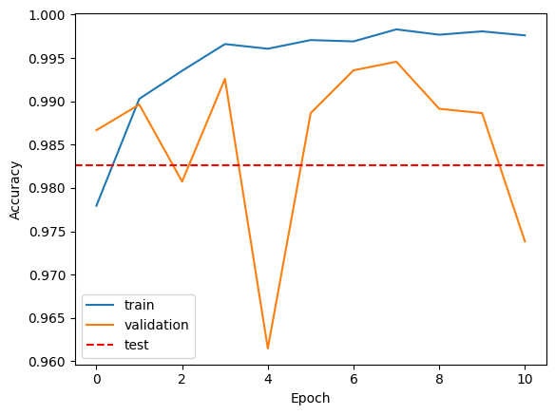
Models
MobileNet CNN Model
Figure 5.2: Baseline, Transfer Learning, Fine Tuning
The baseline gives better performance than transfer Learning and fine tuning in VGG16.

Slide 12
Result Analysis
The VGG16 Transfer Learning Model gives best performance than DenseNet, ResNet50 and MobileNet models.
Figure 6.1: VGG16 Transfer Larning Model

Slide 13
Stakeholders
Traffic monitoring department
Autonomous driving company
Security systems department

Slide 14
Limitation
The dataset doesn’t have much images of vehicles, so if there are new vehicles the model will give wrong result.
The model can only tell is there any vehicle or not. It cannot tell which vehicle is there.

Slide 15
Conclusion
In conclusion the Convolutional Neural Networks is very useful to extract features from images and analysis the images. In this project we are trying to learn different CNN models and use it in our project to see which can give us better result.

Slide 16
Thank You

